Slide 1
SPOTIFY MUSIC WEB APPLICATION
USER INTERFACE DESIGN

Slide 2
Abstract
Digital music distribution is increasingly powered by automated mechanisms that continuously capture, sort and analyze large amounts of Web-based data.
This Web Interface will explores the data catching mechanisms enabled by Spotify Web API, and suggests statistical tools for the analysis of these data.
Special attention is devoted to songs popularity and a Beta model including random effects is proposed in order to give a first answer to questions like: which are the determinants of popularity.
The identification of a model able to describe this relationship, the determination within the set of characteristics of those considered most important in making a song popular

Slide 3
Introduction
Spotify is one of the most famous music Apps in the world.
It is a world leading music sites with more than 30 million tracks collections.
As we know that music apps are one of the most profitable business.
In our project we are going to create an app on the Spotify’s developer platform.

Slide 4
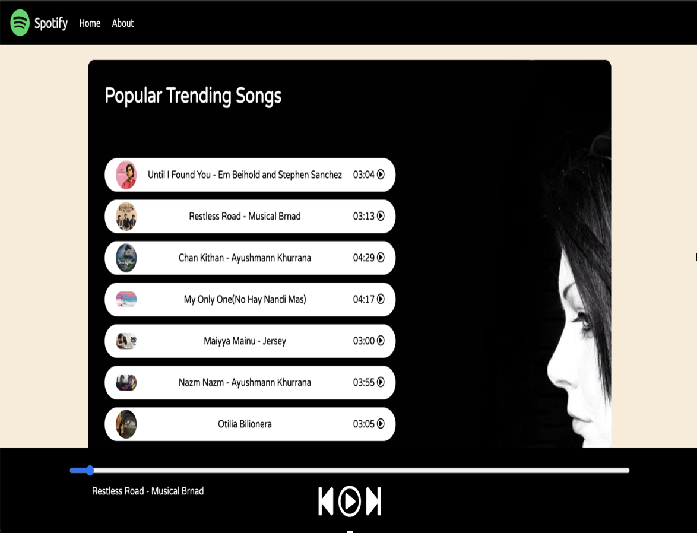
User Interface Layout
Caption

Slide 5
Application
Spotify web application will the best way to listen to music and podcasts on mobile or tablet.
It will build your biggest, best ever music collection.
It will make and shareable playlists
Get inspired with personal recommendations, and readymade playlists for just about everything.

Slide 6
Conclusion
In the rapidly changing economy of the Internet, Spotify stands out as a leading innovator in the field of music streaming.
Starting out in a large field of competitors, Spotify rose quickly to lead the industry in music streaming, and become the service of choice for millions of users.
Spotify was able to achieve success and attract a greater library of music to offer the users, which in turn increased the network and the power of Spotify.
Spotify’s network of users exist within an ever-changing digital world where technology advances at a great rate, and competitors arise on a regular basis.

Slide 7
Reference
https://github.com/hrprem16/Spotify-Clone
https://www.spotify.com/in-en/free/utm_source
https://developer.spotify.com/documentation/web-api/

Slide 8
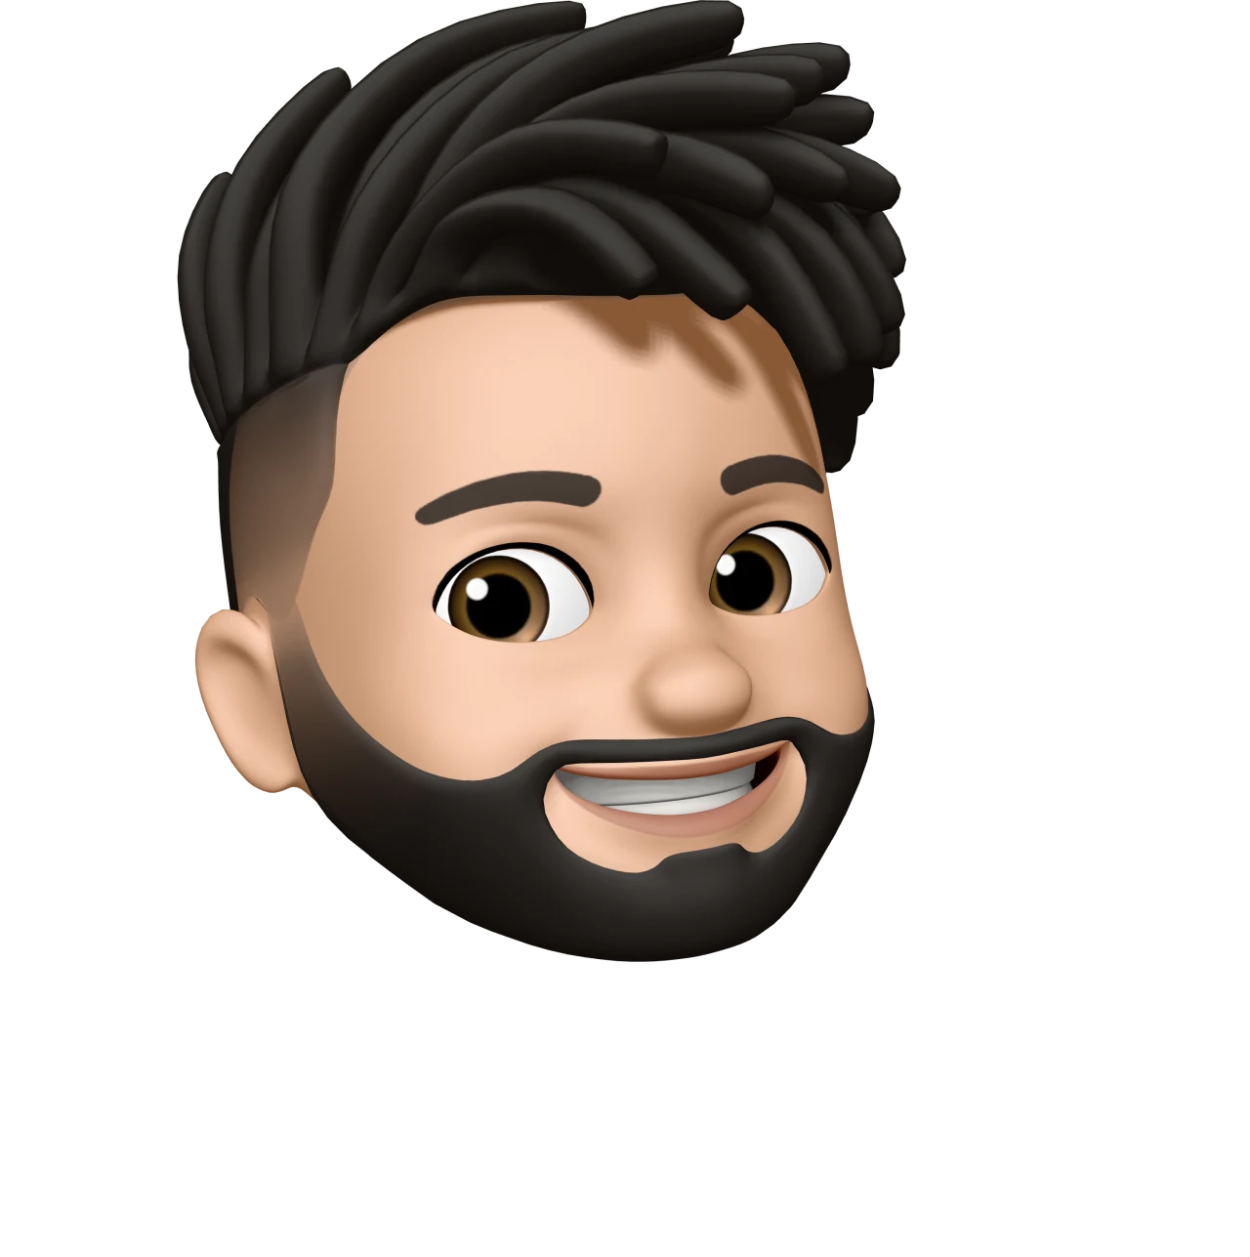
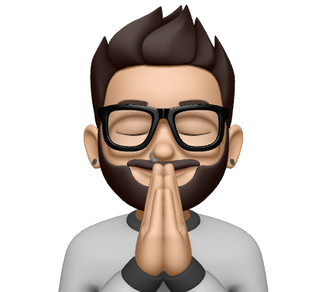
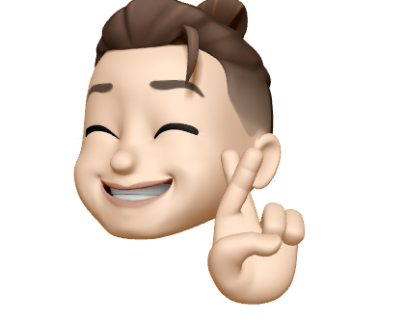

Meet The Team
Nilay A
(RA2011033010056)
Prem Kumar
RA2011033010057
Ashish Prakash Singh
(RA2011033010060)
Rimendra Kumar Agrawal
(RA2011033010064)

Slide 9
Thank You 🙏

